Slide 1
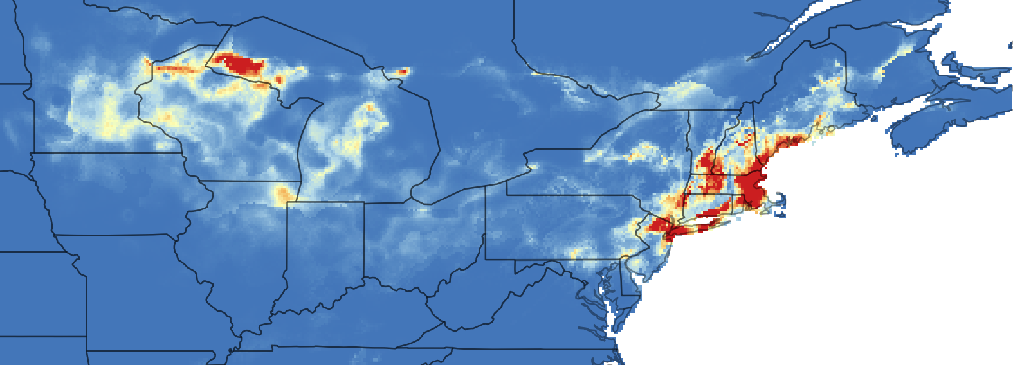
Species Distribution Modeling for Conservation in R and Wallace
Matt Aiello-Lammens, Pace University
Andrea Paz, CUNY
Gonzalo Pinilla, CUNY
Pete Galante, AMNH
Erica Johnson, CUNY

Slide 2
Workshop Overview
Intro to SDMs and Wallace – 40 min (Matt)
Crash Course in R – 20 min (Matt)
Making SDMs using Wallace – 60 min (Gonzalo)
Analyses Beyond Wallace - Getting and checking occurrence data – 30 min (Andrea)

Slide 3
What is a species distribution?
How might knowing a species distribution help in conservation science?

Slide 4
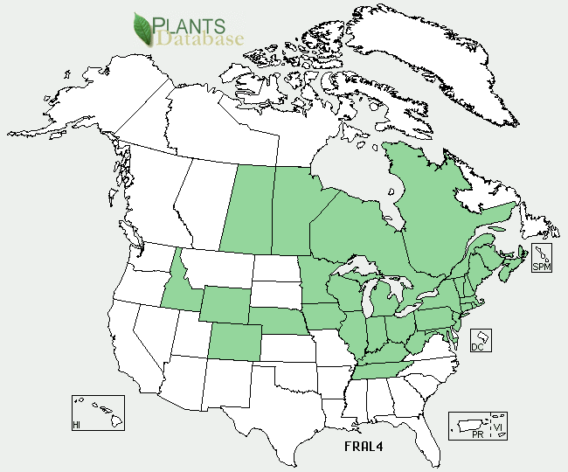
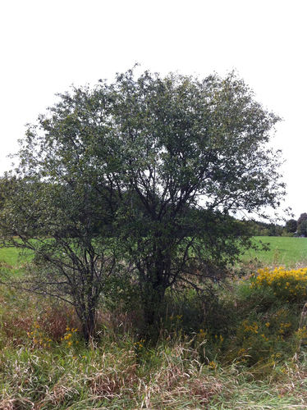
Identifying species distributions
Frangula alnus
Notes:
What methods do we have to identify a species distribution?
For the remainder of the talk, I'm going to refer to the species Frangula alnus (Glossy buckthorn), because it was the focus of my PhD work.

Slide 5
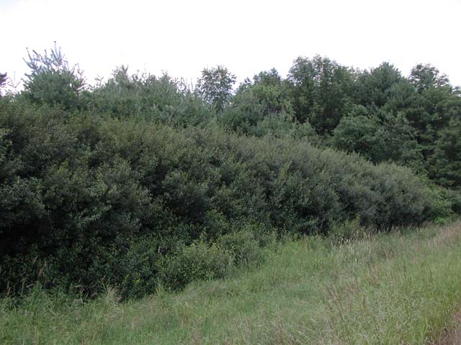
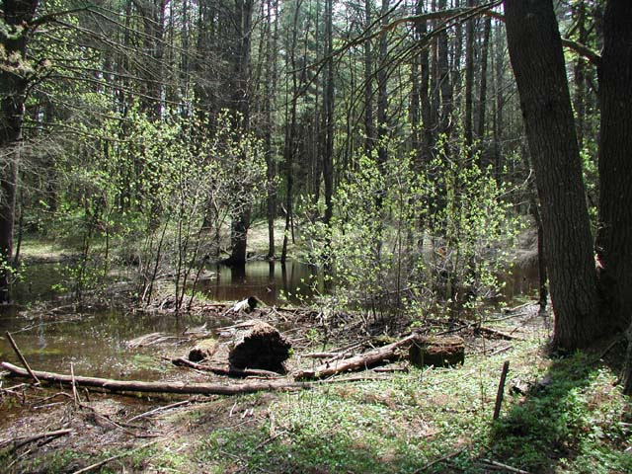
Species distribution model
Glossy buckthorn is observed in …
Old fields
Wetlands
Full to partial sun light (but not deep understories)

Slide 6
Species distribution model
Glossy buckthorn is observed in …
Prob(suitable for GB) ~
Sun light + Land cover + Soil moisture

Slide 7
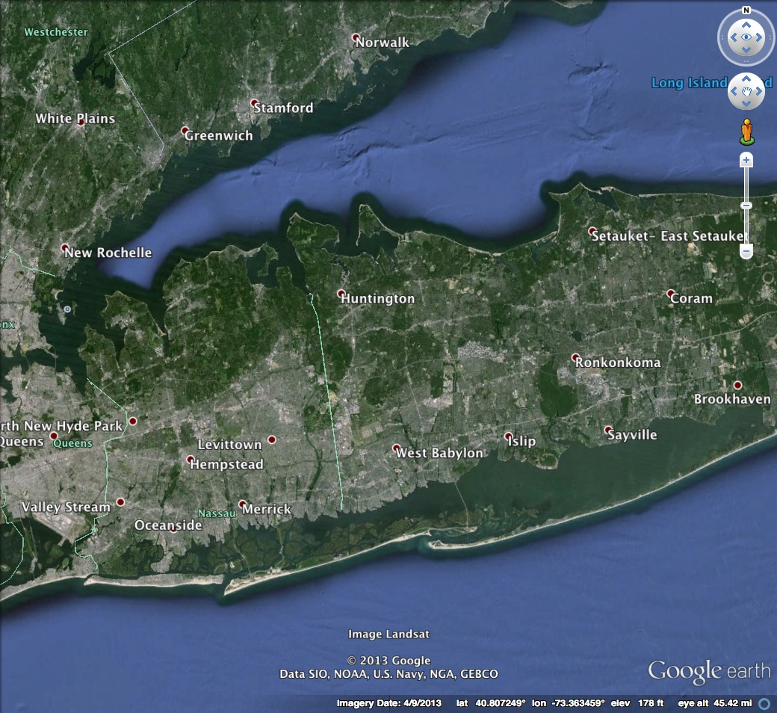
Species distribution model

Slide 8
Species distribution model
Notes:
What I’m talking about here are pretty site specific conditions

Slide 9
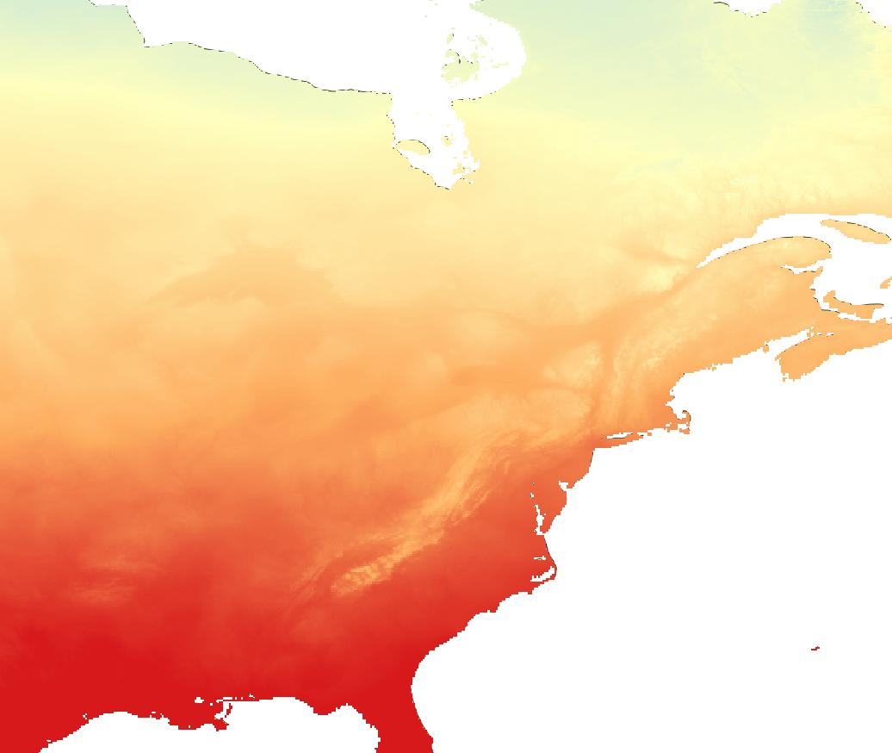
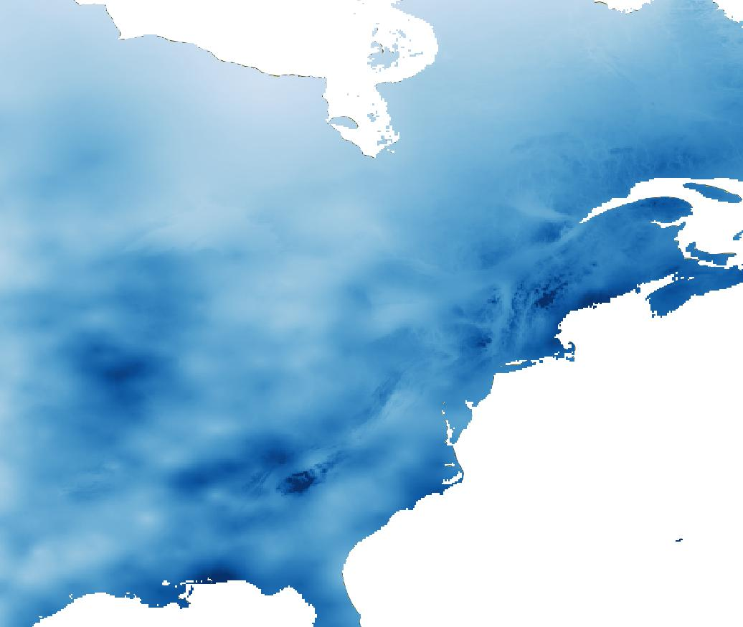
Species distribution model
Mean Annual
Temperature
Total
Precipitation
Notes:
We know that at large scales weather and climate patterns also play a role in shaping the distribution of glossy buckthorn

Slide 10

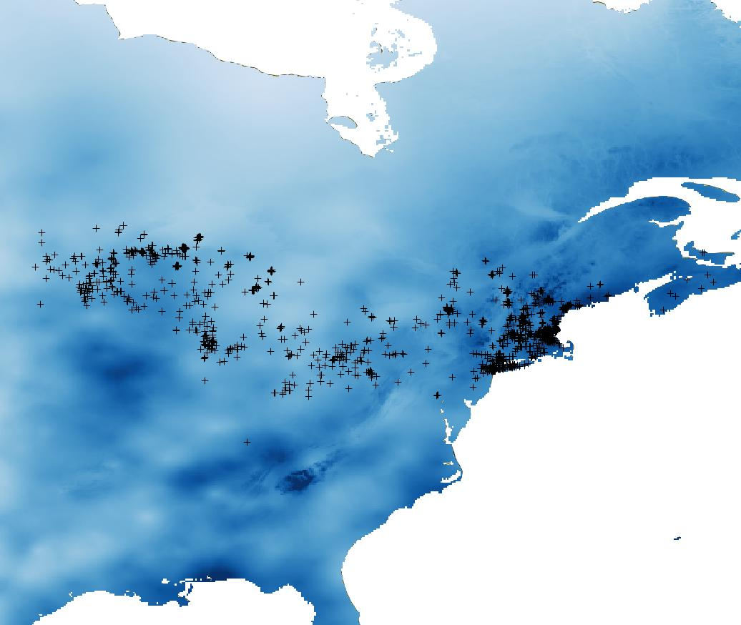
Species distribution model
GB Presence =
Mean Annual Temperature + Total Precipitation + …
Notes:
Black dots are observed presence locations

Slide 11
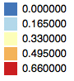
Species distribution model
GB Suitability ~
Mean Annual Temperature + Total Precipitation + …

Slide 12
Model algorithms – some approaches that have been applied:
Method(s) | Model/software name
Gower Metric | DOMAIN
Ecological Niche Factor Analysis (ENFA) | BIOMAPPER
Maximum Entropy | MAXENT
Genetic algorithm | GARP
Regression (GLM, GAM, BRT, MARS) | Implemented in R
Artificial Neural Network (ANN) | SPECIES
Multiple methods | BIOMOD
Commonalities among occurrence locations
Comparison between occurrences and absences (pseudo-absence*)
Comparison between occurrences and background
* Complex and somewhat controversial issue
Notes:
‘Method’ refers to a statistical or machine-learning technique. ‘Model/software name’ refers to a name (or acronym) given to a published model that implements the method(s) stated. ‘Species data type’ refers to the type of species distribution data required (see slide 28 for further explanation). ‘R’ is a free software environment for statistical computing and graphics.
Regression acronyms: generalized linear model (GLM), generalized additive model (GAM), boosted regression trees (BRT), multivariate adaptive regression splines (MARS).
Emphasize that it is not possible to recommend a single approach – each method has pros and cons, and different methods may be best for different applications. Later in the presentation we will look at studies that compare results between different methods.

Slide 13
CURRENT distribution of buckthorn
Glossy buckthorn does better in places with warmer winters
Notes:
Bio6 (min temp coldest month) and Grass most important variables

Slide 14
CURRENT distribution of buckthorn
Glossy buckthorn does not do well with long growing seasons
Notes:
Bio6 (min temp coldest month) and Grass most important variables

Slide 15
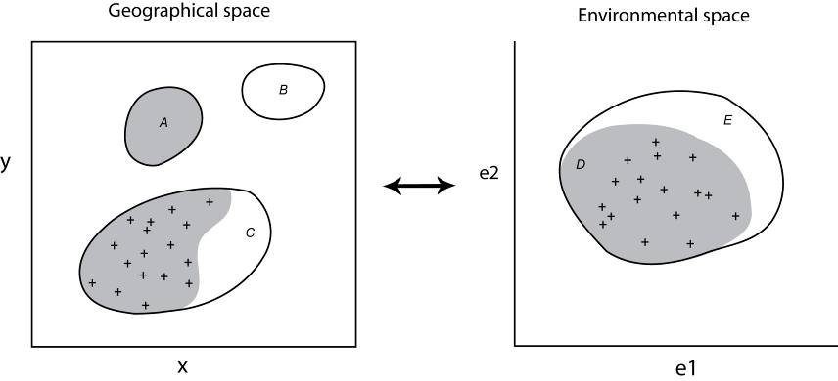
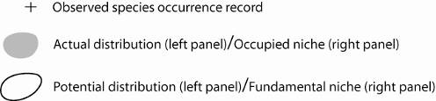
Diagram illustrating the relationship between species’ position in geographical space and environmental space
Notes:
Geographical space refers to spatial location as commonly referenced using x and y coordinates. Environmental space refers to Hutchinson’s n-dimensional niche, illustrated here for simplicity in only two dimensions (defined by two environmental factors, e1 and e2). Crosses represent observed species occurrence records. Grey shading in geographical space represents the species’ actual distribution (i.e. those areas that are truly occupied by the species). Notice that some areas of actual distribution may be unknown (e.g. area A is occupied but the species has not been detected there). The grey area in environmental space represents that part of the niche that is occupied by the species: the occupied niche. Again, notice that the observed occurrence records may not identify the full extent of the occupied niche (e.g. the shaded area immediately around label D does not include any known localities). The solid line in environmental space depicts the species’ fundamental niche, which represents the full range of abiotic conditions within which the species is viable. In geographical space, the solid lines depict areas with abiotic conditions that fall within the fundamental niche; this is the species’ potential distribution. Some regions of the potential distribution may not be inhabited by the species due to biotic interactions or dispersal limitations. For example, area B is environmentally suitable for the species, but is not part of the actual distribution, perhaps because the species has been unable to disperse across unsuitable environments to reach this area. Similarly, the non-shaded area around label C is within the species’ potential distribution, but is not inhabited, perhaps due to competition from another species. Thus, the non-shaded area around label E identifies those parts of the fundamental niche that are unoccupied, for example due to biotic interactions or geographical constraints on species dispersal.

Slide 16
Diagram illustrating the relationship between species’ position in geographical space and environmental space
Notes:
Geographical space refers to spatial location as commonly referenced using x and y coordinates. Environmental space refers to Hutchinson’s n-dimensional niche, illustrated here for simplicity in only two dimensions (defined by two environmental factors, e1 and e2). Crosses represent observed species occurrence records. Grey shading in geographical space represents the species’ actual distribution (i.e. those areas that are truly occupied by the species). Notice that some areas of actual distribution may be unknown (e.g. area A is occupied but the species has not been detected there). The grey area in environmental space represents that part of the niche that is occupied by the species: the occupied niche. Again, notice that the observed occurrence records may not identify the full extent of the occupied niche (e.g. the shaded area immediately around label D does not include any known localities). The solid line in environmental space depicts the species’ fundamental niche, which represents the full range of abiotic conditions within which the species is viable. In geographical space, the solid lines depict areas with abiotic conditions that fall within the fundamental niche; this is the species’ potential distribution. Some regions of the potential distribution may not be inhabited by the species due to biotic interactions or dispersal limitations. For example, area B is environmentally suitable for the species, but is not part of the actual distribution, perhaps because the species has been unable to disperse across unsuitable environments to reach this area. Similarly, the non-shaded area around label C is within the species’ potential distribution, but is not inhabited, perhaps due to competition from another species. Thus, the non-shaded area around label E identifies those parts of the fundamental niche that are unoccupied, for example due to biotic interactions or geographical constraints on species dispersal.

Slide 17
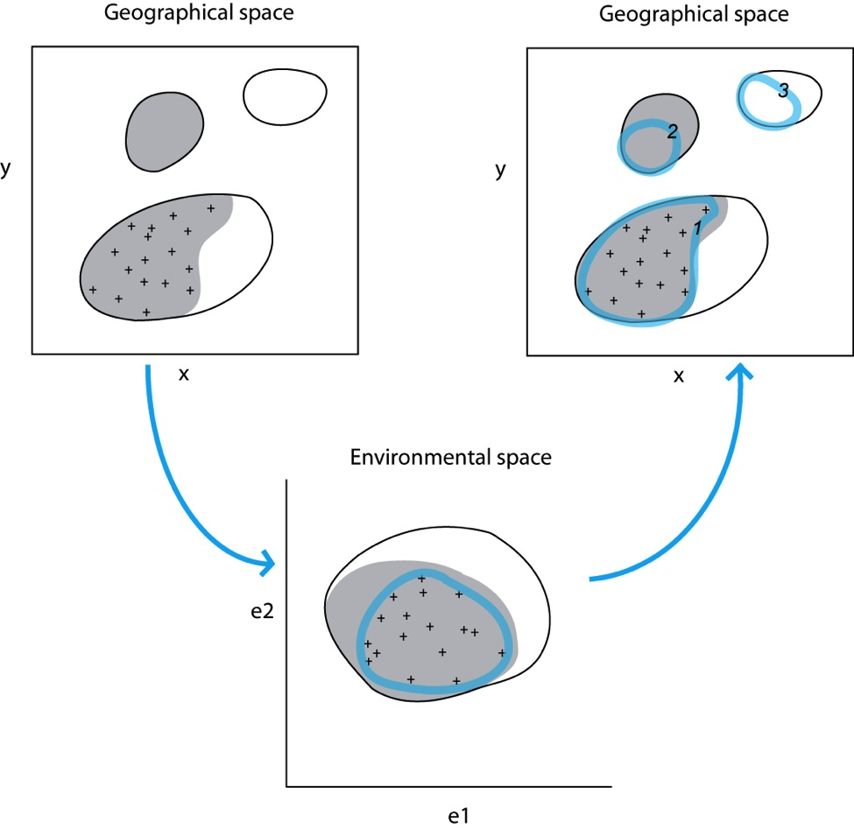
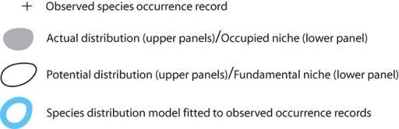
Illustration of the general species’ distribution modeling approach
Notes:
Notice that the diagram uses the same hypothetical case as in the previous slide. A modelling technique (e.g. GARP, Maxent) is used to characterize the species’ niche in environmental space by relating observed occurrence localities to a suite of environmental variables. Notice that, in environmental space, the model may not identify either the species’ occupied niche or fundamental niche; rather, the model identifies only that part of the niche defined by the observed records. When projected back into geographical space, the model will identify parts of the actual distribution and potential distribution. For example, the model projection labeled 1 identifies the known distributional area. Projected area 2 identifies part of the actual distribution that is currently unknown; however, a portion of the actual distribution is not predicted because the observed occurrence records do not identify the full extent of the occupied niche (i.e. there is incomplete sampling; see area D on the previous slide). Similarly, modeled area 3 identifies an area of potential distribution that is not inhabited (the full extent of the potential distribution is not identified because the observed occurrence records do not identify the full extent of the fundamental niche due to, for example, incomplete sampling, biotic interactions, or constraints on species dispersal; see areas D and E on the previous slide).

Slide 18
Two key factors determining the degree to which observed localities can be used to estimate the niche or distribution:
Equilibrium: A species is said to be at equilibrium with current environmental conditions if it occurs in all suitable areas, whilst being absent from all unsuitable areas. The degree to which a species is at equilibrium depends both on biotic interactions (e.g. competitive exclusion from an area) and dispersal ability.
Sampling adequacy: The extent to which the observed occurrence records provide a sample of the environmental space.
Notes:
Regarding equilibrium: For example, the degree of equilibrium for different groups of organisms in Europe varies considerably, with more dispersive species (e.g. birds) relatively closer to equilibrium than less dispersive species (e.g. reptiles) (Araújo & Pearson 2005). Regarding sampling adequacy: In some instances, very few occurrence records may be available, perhaps due to limited survey effort. In such cases, the available records are unlikely to provide a sample of available environments that is sufficient to enable to the full range of conditions occupied by the species to be identified. In other cases, surveys may have provided extensive occurrence records that provide a fairly accurate picture as to the environments inhabited by a species in a particular region (e.g. European plant data). Each of these factors (equilibrium and sampling adequacy) should be carefully considered to ensure appropriate use of a species’ distribution model

Slide 19
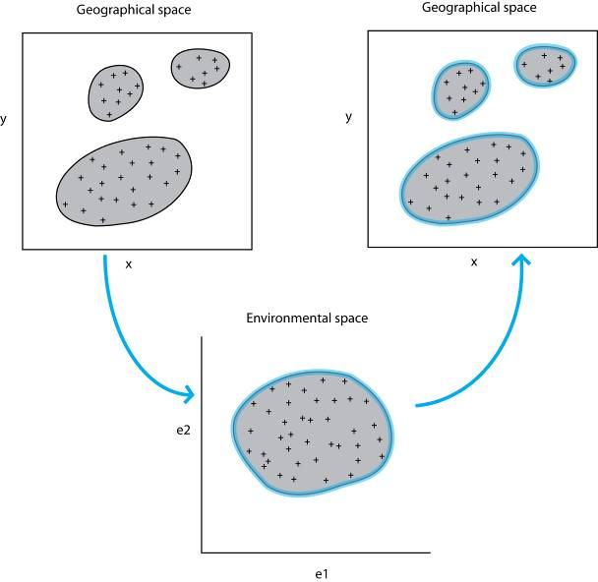
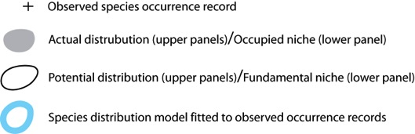
Suppose equilibrium and good sampling: the ideal scenario
Notes:
In the ideal case, the species of interest would be at equilibrium and we would have complete sampling of the environment. In such a case the actual and potential distributions would be identical and we would expect to model both accurately. However, how useful is the model under these circumstances?

Slide 20
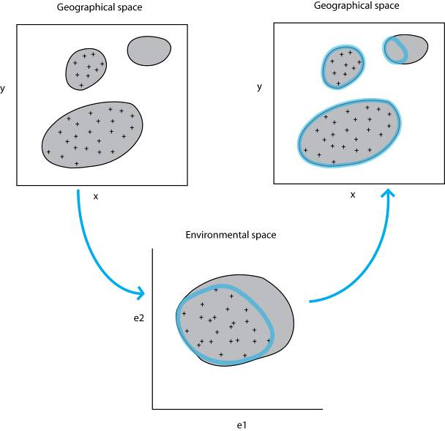
Suppose high equilibrium but poor sampling (in both geographical and environmental space)
Notes:
In this case, the model identified part of the species actual distribution that is unknown. This type of prediction can be extremely useful for guiding field surveys since additional sampling will yield new species records.

Slide 21

Suppose high equilibrium and poor sampling in geographical space, but good sampling in environmental space
Notes:
Note that there is not necessarily a direct relationship between sampling adequacy in geographical space and in environmental space. It is quite possible that poor sampling in geographical space could still result in good sampling in environmental space. For example, if a geographic area that has not been sampled has environmental conditions that are similar to those in an area that has been sampled, then sampling adequacy in environmental space will not be affected.

Slide 22
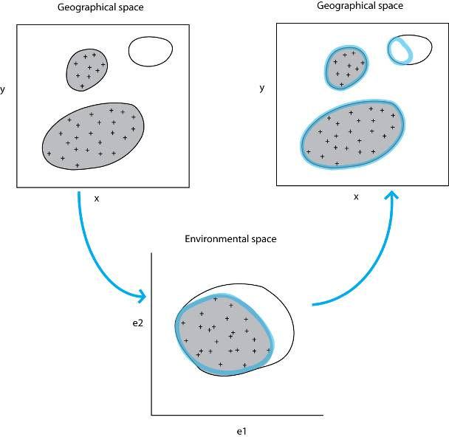
Suppose low equilibrium but good sampling
Notes:
In this case the model identified an area of potential distribution that is environmentally similar to where the species has been observed, but which is not inhabited. This type of prediction may be very useful for identifying sites suitable for the reintroduction of an endangered species, identifying areas where the species may become invasive, or guiding field surveys toward the discovery of unknown species that are closely related. Distribution models may therefore prove useful even in cases where species’ equilibrium is low.

Slide 23
Back to our first example: in reality we have a combination of
dis-equilibrium and incomplete sampling
So, we must be very cautious when interpreting model output: to what degree have we been able to capture the potential and/or actual distribution?

Slide 24
Uses of species distribution models
The data required to construct these models are relatively easy to get
On-line databases like GBIF, EDDMaps, iNaturalist, eBird, etc. (Andrea will talk more about this!)

Slide 25
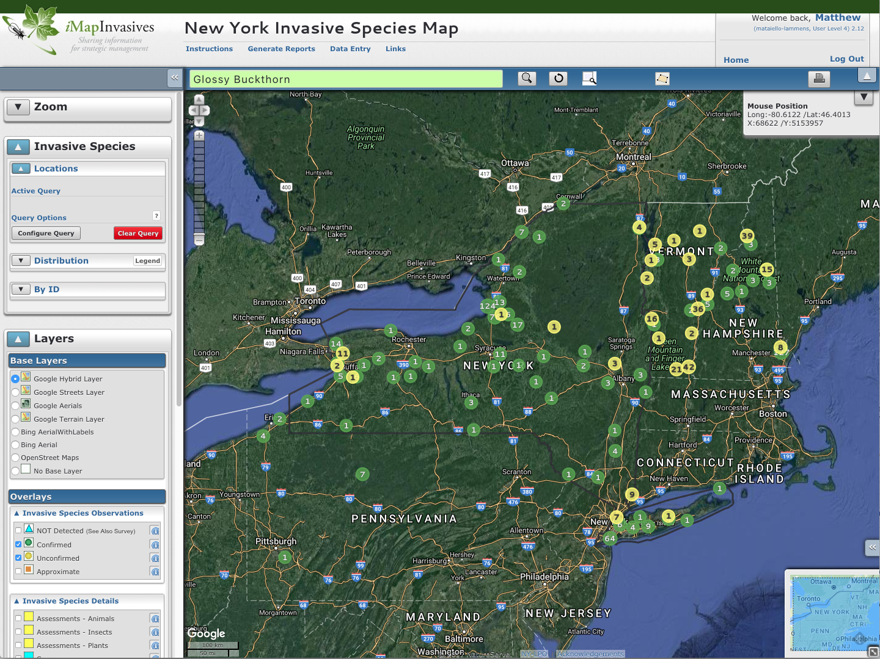

Slide 26
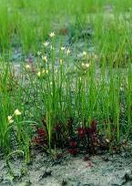
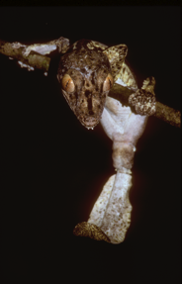
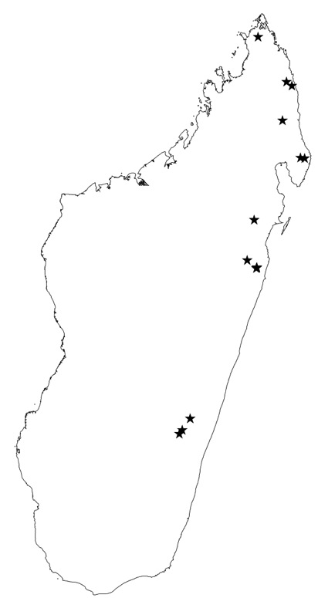
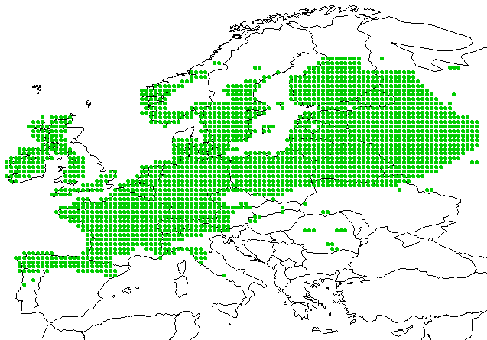
Occurrence data: presence-only or presence/absence?
Presence and (assumed) absence data for a plant in Europe
Presence-only data for a gecko in Madagascar
Notes:
Species distribution data may be presence-only, or presence and absence. Two contrasting examples are shown here: Madagascar (black stars are ‘presences’) and Europe (green dots show presences). In some instances, ‘absence’ may be assumed in cases where no occurrence has been recorded. This is most defendable in regions that have been well surveyed.
Maybe ask the students: How would we expect these study regions to differ in terms of the intensity of data sampling that has taken place?
Response: Europe has experienced intense sampling for many years, whilst Madagascar is relatively poorly known. It is therefore common for areas in Europe where a species has not been recorded to be used as ‘absences’ in species distribution modeling. In contrast, although a species may not have been recorded in an area of Madagascar, it would not be safe to assume that the species is absent from the area.
Before moving on too the next slide, ask students to consider why a species might be recorded as absent from a region (i.e, dispersal limitation, environmental unsuitability, competition, or it was simply undetected?)

Slide 27
When is an observed species absence really an absence of suitable conditions?
A species may be classified as ‘absent’ for a number of reasons, but this does not necessarily denote absence of suitable conditions:
'False absence'
The species could not be detected, even though it was present
The species was absent, even though the environment is suitable (e.g. due to dispersal limitation, or metapopulation dynamics)
The environment is truly unsuitable for the species
'False absence'
'True absence'
Take care when using ‘absence’ data
Notes:
This is an important point that will be referred to again when discussing model algorithms (some use absence data, whilst others do not) and model evaluation approaches (should absence data be used?). Students may be asked to name the 3 types of absences before they are displayed in the presentation.

Slide 28
Uses of species distribution models
The data required to construct these models are relatively easy to get
On-line databases like GBIF, EDDMaps, iNaturalist, eBird, etc.
Climate layers easy to get, other environmental variables also accessible

Slide 29
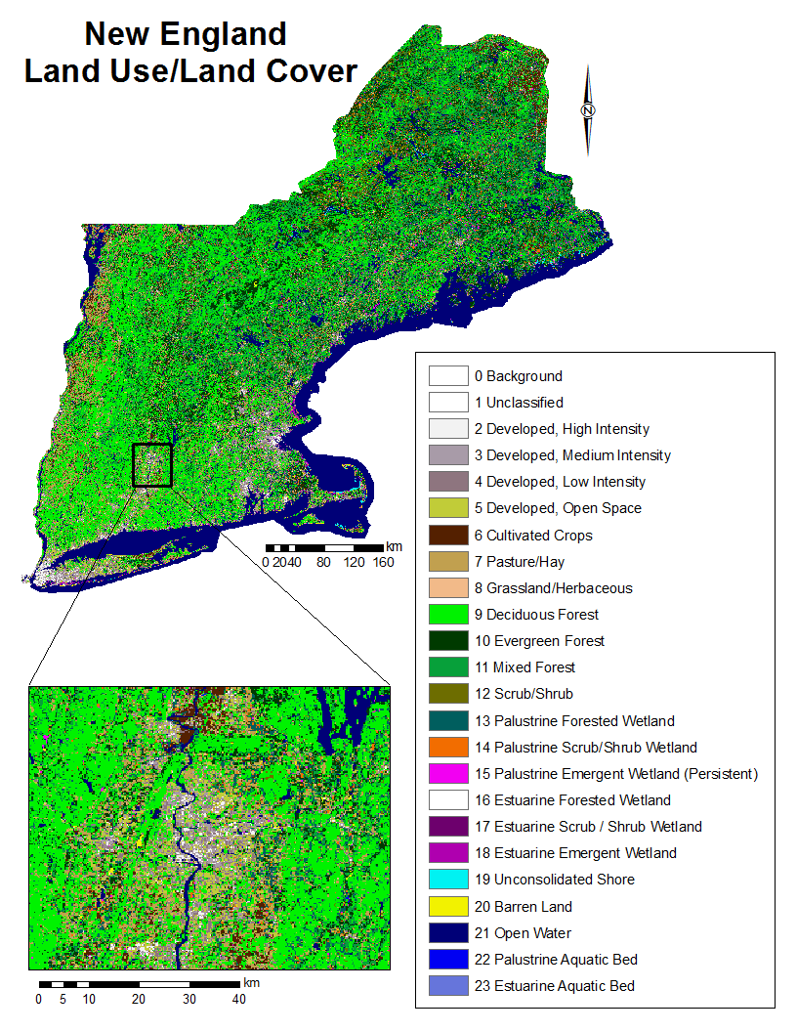
Land-use/Land-cover (LULC): for northeast
These are derived from satellite images that have been classified into a suite of standardized land-use types (20-40 types).
30m grid cell resolution from Landsat satellites

Slide 30
Uses of species distribution models
The data required to construct these models are relatively easy to get
On-line databases like EDDMaps, iNaturalist, iMap Invasives
Climate layers easy to get, other environmental variables also accessible
Future climate forecasts are available and getting better every day

Slide 31


Slide 32
CURRENT distribution of buckthorn
GB Suitability ~
Mean Annual Temperature + Total Precipitation + …

Slide 33
CURRENT distribution of buckthorn
Glossy buckthorn does better in places with warmer winters
Notes:
Bio6 (min temp coldest month) and Grass most important variables

Slide 34
CURRENT distribution of buckthorn
Glossy buckthorn does not do well with long growing seasons
Notes:
Bio6 (min temp coldest month) and Grass most important variables

Slide 35
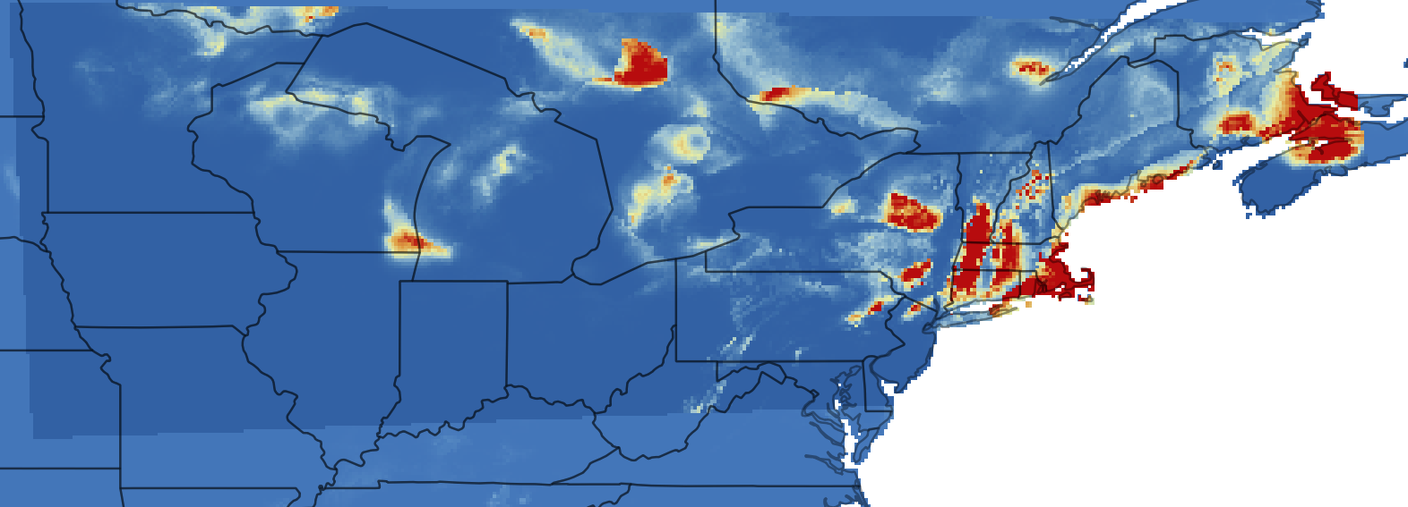
FUTURE distribution of buckthorn
Future GB Suitability ~
Future Mean Annual Temperature + Future Total Precipitation + …

Slide 36
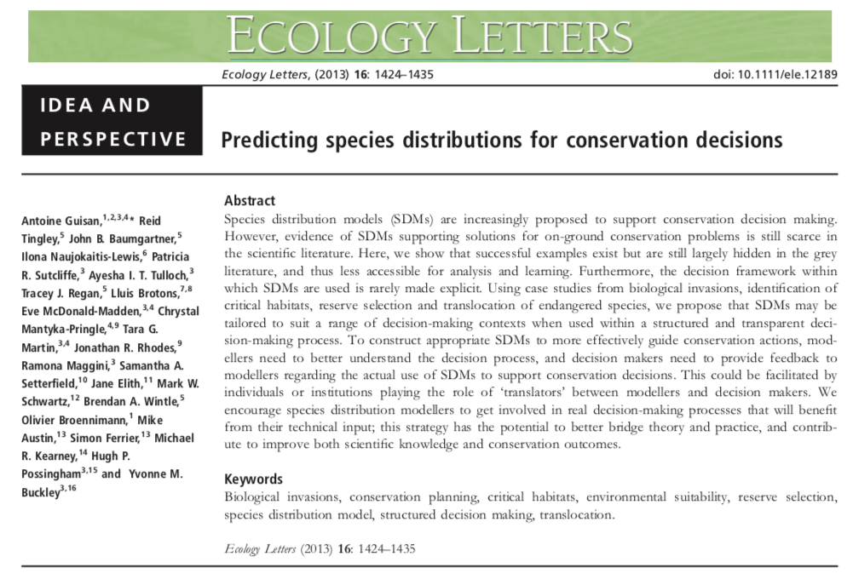
Applications to Conservation Science

Slide 37
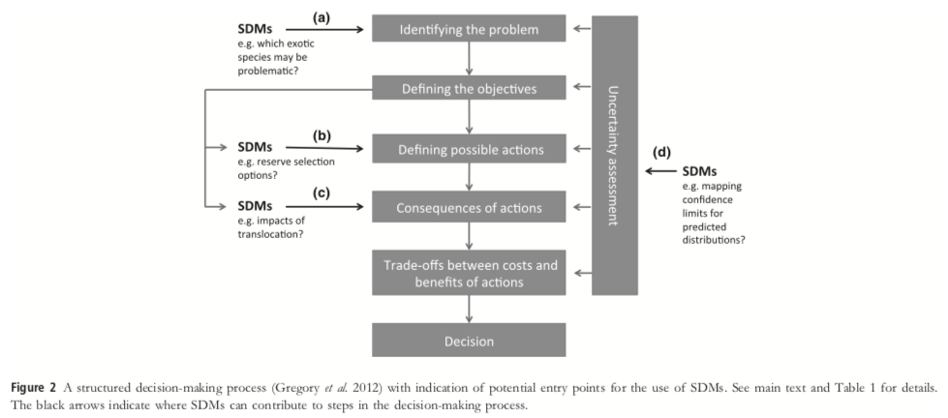
Applications to Conservation Science

Slide 38
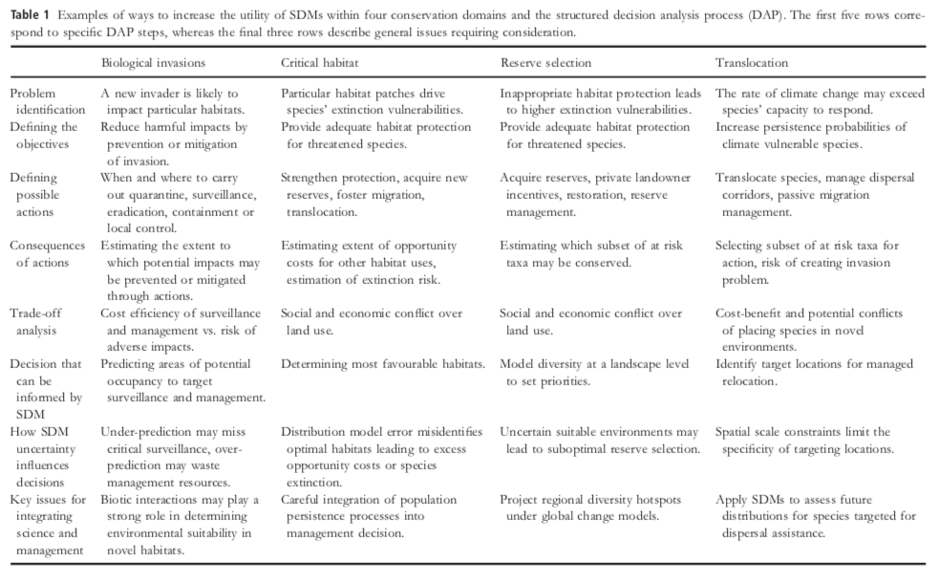
Applications to Conservation Science

Slide 39
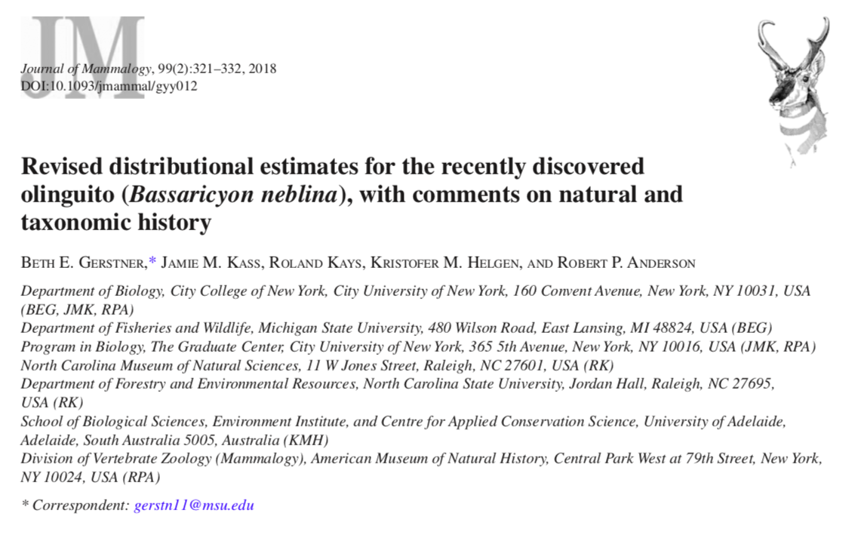
Applications to Conservation Science

Slide 40
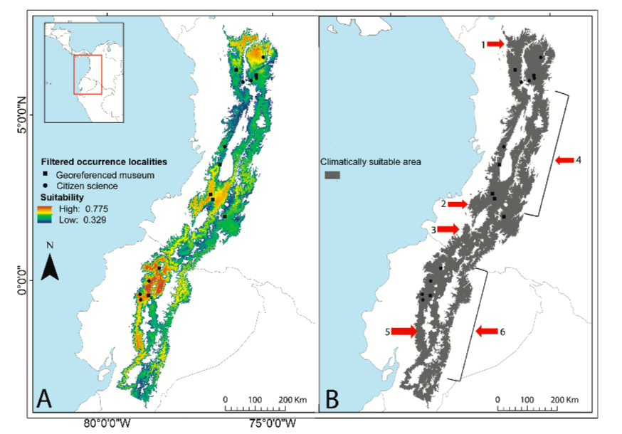

Slide 41
Final Cautionary Notes!
The use and misuse of models
“All models are wrong, but some are useful” George Box
Garbage in, garbage out: a model is only as good as the data put into it.
Model extrapolation: should be treated with a great deal of caution.
The lure of complicated technology: Remember that a model can only be useful if the theoretical underpinnings on which it is based are sound, regardless of how advanced the data and technology are.
Notes:
We must always be aware of the limitations of ecological models. Garbage in, garbage out: if the occurrence records used to build a correlative species’ distribution model do not provide useful information as to the environmental requirements of the species, then the model cannot provide useful output. Model extrapolation: ‘Extrapolation’ refers to the use of a model to make predictions for environmental values that are beyond the range of the data used to calibrate the model. Model extrapolation should be treated with a great deal of caution. The lure of complicated technology: Many approaches to modeling species’ distributions utilize complex computational technology (e.g. artificial neural networks and genetic algorithms) along with huge GIS databases of digital environmental layers. “Wow – it must be correct!” Remember that a model can only be useful if the theoretical underpinnings on which it is based are sound.
This is the end of the section (and a convenient stopping point if the presentation is to be spread over multiple lectures) – break for questions on the modeling theory. Students may be asked to give examples of when a species does not occupy its full fundamental niche (e.g. invasive species, such as fire ants or cheatgrass) and to list reasons why a species may not occupy its full fundamental niche (e.g. geographic barriers, such as mountain ranges or rivers, or competition with other species).

Slide 42
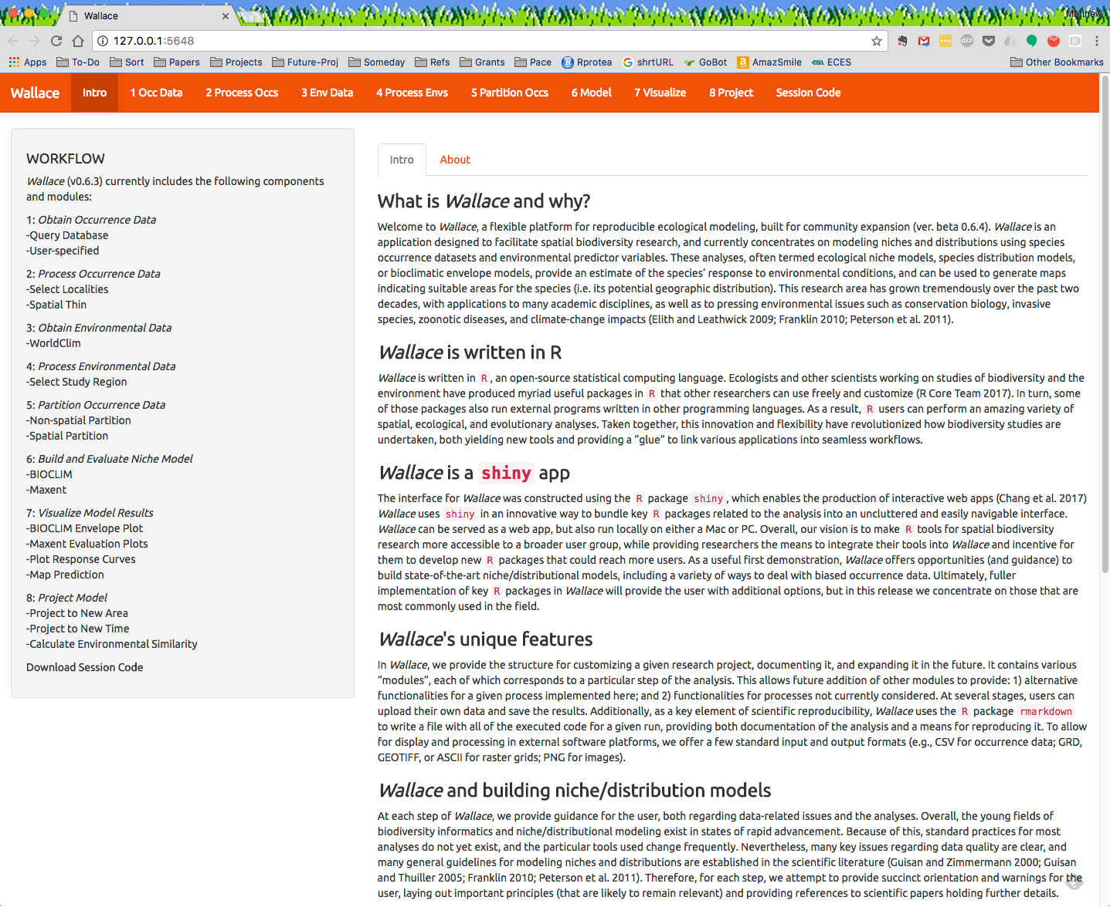
These models constructed in Wallace – an R package designed to implement and teach best practices in distribution modeling
https://wallaceecomod.github.io/

Slide 43
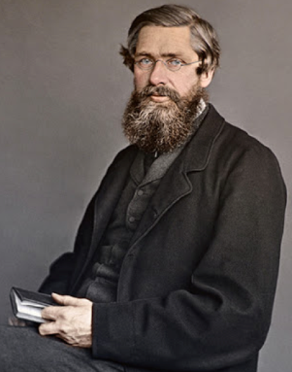
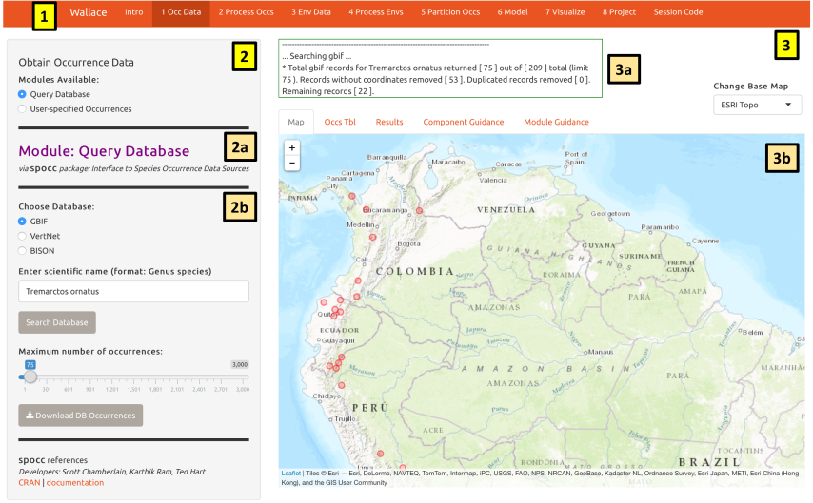
Wallace
Wallace: A New Modular GUI Software for Modeling Species Niches and Distributions
What is Wallace? And Why?
What is Wallace not?

Slide 44




Range estimates needed

Slide 45

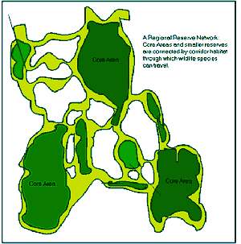

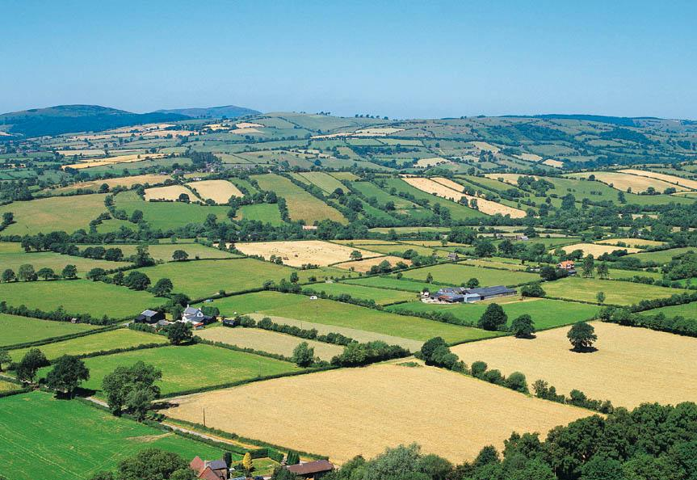
Range estimates needed
Reserve planning
Invasive species
Land-use policies
Zoonotic diseases

Slide 46
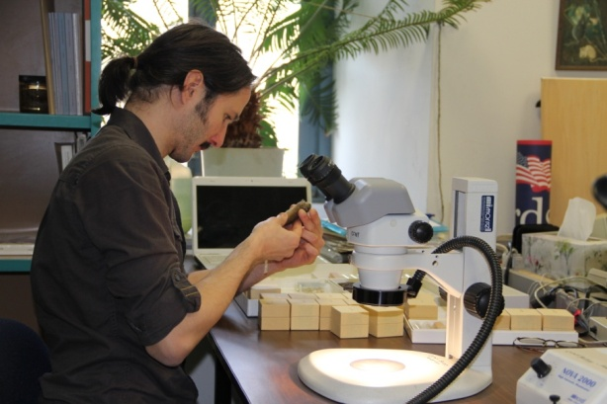

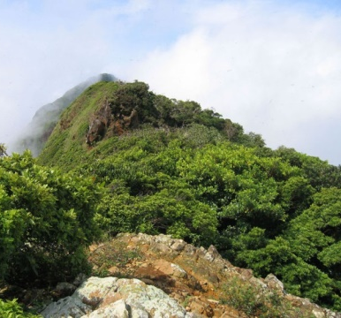
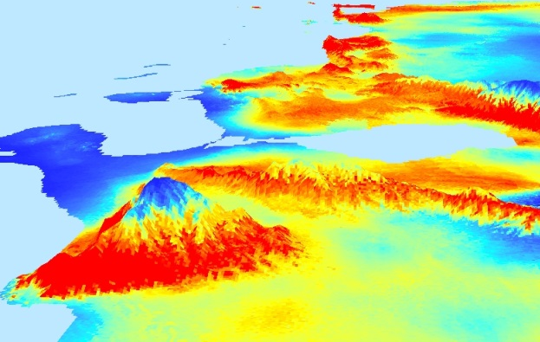
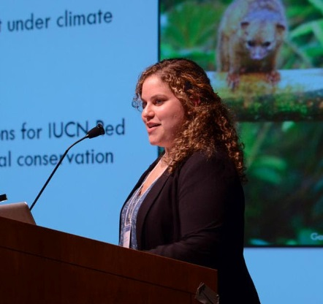
Anderson lab studies spatial and temporal patterns of environmental suitability …
… and their ecological, evolutionary, and practical consequences
Notes:
46

Slide 47
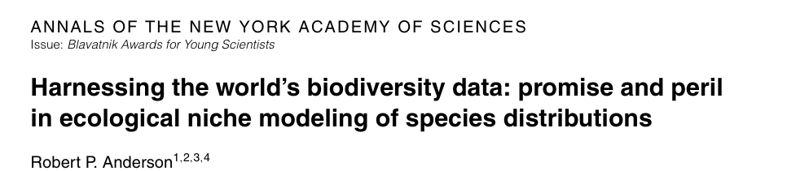
Agenda: applied biodiversity informatics
1. High-quality data, ready to be accessed when the particular problem presents itself
2. Software that achieves an appropriate balance between automation and supervision
3. Scientists capable of building, applying, and appraising high-quality models

Slide 48
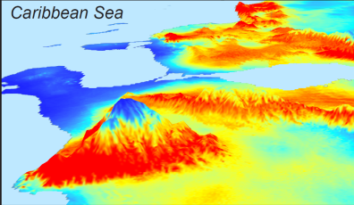
Correlative modeling of species niches and ranges
Occurrence records
Suitable areas
Model of niche
Algorithm
Environmental data

Slide 49
Correlative modeling of species niches and ranges
another place
Occurrence records
Suitable areas
Model of niche
Algorithm
Environmental data
another time
Conservation, invasive species, zoonotic diseases, climate change

Slide 50
Agenda: applied biodiversity informatics
Anderson (2012)
Software that achieves an appropriate balance between automation and supervision
automates repetitive aspects
forces user to make critical biological and conceptual decisions
general with respect to algorithms used

Slide 51
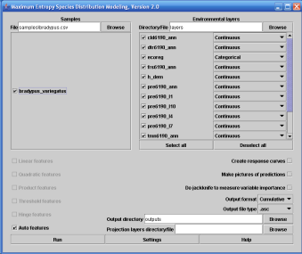
Problems with existing analyses
Existing GUIs
(too) easy
default settings
inflexible
infrequently updated
strings of applications

Slide 52
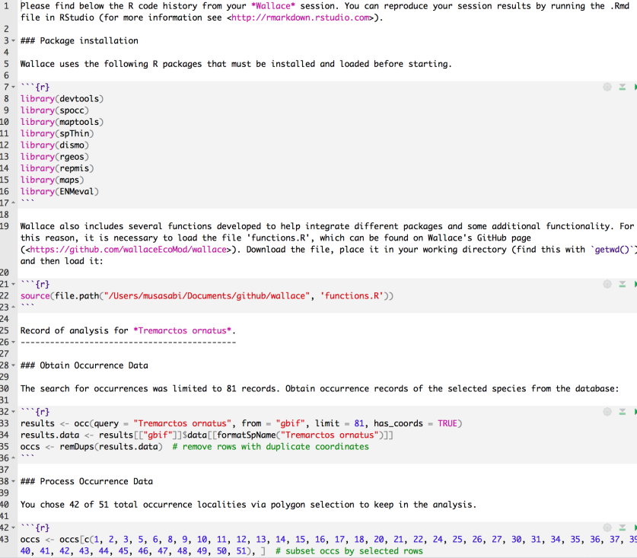
Problems with existing analyses
Existing GUIs
(too) easy
default settings
inflexible
infrequently updated
strings of applications
Code
error-prone
not easily generalizable
slow to be taken up

Slide 53
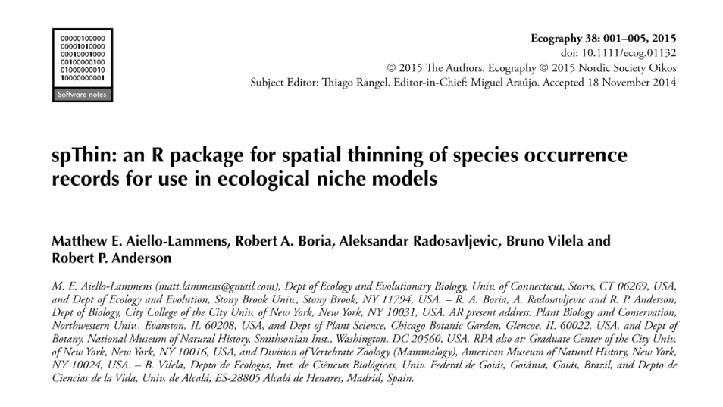
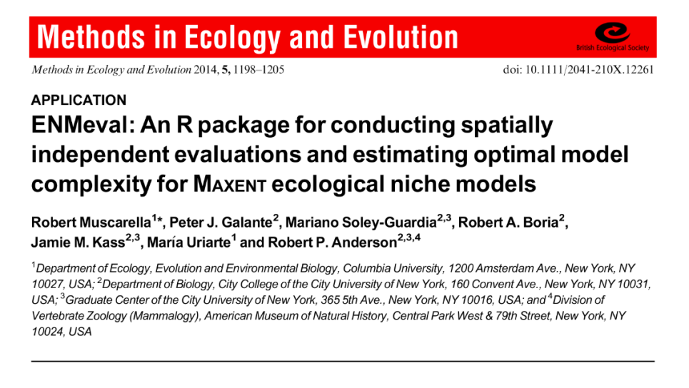


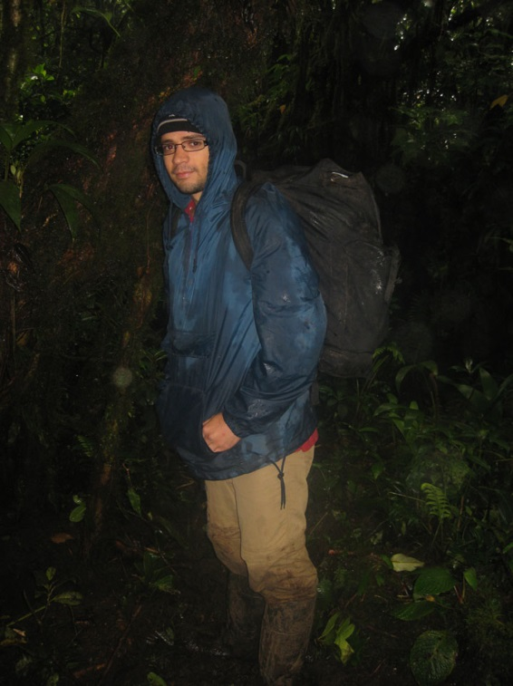


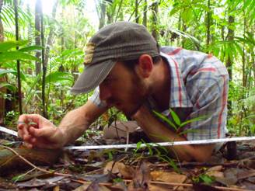
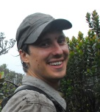

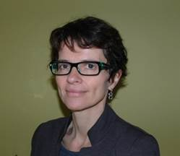

Recent-ish R packages: spThin and ENMeval
Matthew Aiello-Lammens
Robert Muscarella
Robert Anderson, Robert Boria, Peter Galante, Jamie Kass,
Aleksandar Radosavljevic, Mariano Soley-Guardia, Maria Uriarte, Bruno Vilela

Slide 54
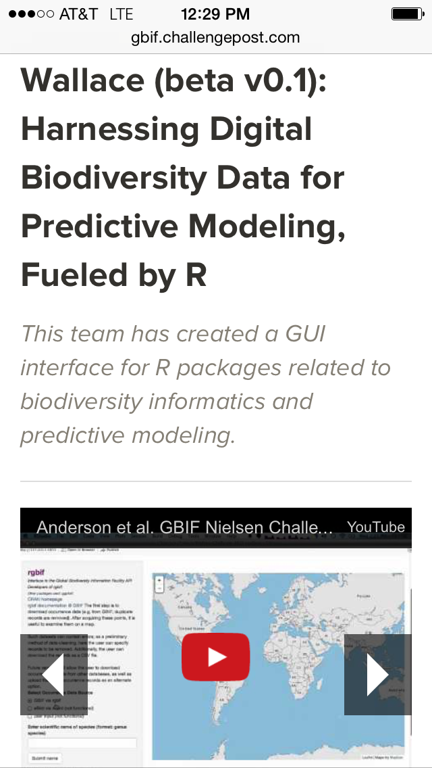

From R to a GUI
Innovative use of GBIF occurrence data

Slide 55

Combine code-based methods with GUI
Foreground:
Flexible, interactive, expandable GUI
Background:
R code from new packages: reproducible

Slide 56
















Slide 57








Ever-expanding Wallace contributors
Jamie M. Kass, Bruno Vilela, Matthew E. Aiello-Lammens, Robert Muscarella, Cory Merow & Robert P. Anderson
… and Mary E. Blair, Ned Horning, Jorge Velásquez-Tibatá, Gonzalo E. Pinilla-Buitrago, Beth E. Gerstner & Sarah I. Meenan
… and Olivier Broennimann, Brian S. Maitner, Hannah L. Owens & Sara Varela

Slide 58

What is Wallace NOT?
A full replacement for general GIS software
A software that is perfect
A software that does EVERYTHING you want to study niches and distributions

Slide 59
What is Wallace?
Point-and-click (GUI) application that includes most steps of a niche/distribution modeling workflow
Harnesses R packages and gives credit to their authors
Currently expanding …

Slide 60





Slide 61

Installing Wallace
Install R (and optionally Rstudio) and Java
Install the wallace package from CRAN
OPTIONAL: For maxent.jar need to install additional files -- (https://biodiversityinformatics.amnh.org/open_source/maxent/ and place in dismo folder
Troubleshooting on Github page (https://github.com/wallaceEcoMod/wallace)

Slide 62

Qualities of Wallace
Wallace’s code is free and open
(& users can download data from online databases.)

Slide 63

Qualities of Wallace
Wallace provides guidance
that addresses conceptual and methodological issues.

Slide 64

Qualities of Wallace
Wallace is flexible
by providing multiple options, and allowing user inputs and downloads for most components.

Slide 65

Qualities of Wallace
Wallace features interactive
maps, tables, and graphs to explore data and model predictions.

Slide 66
Qualities of Wallace
Wallace is reproducible
by providing executable code for documenting and rerunning the analysis.

Slide 67

Wallace today
1. Full Release 1.0.6 (Kass et al. 2018, Methods in Ecology & Evolution software note; Google group; Wallace e-mail)
NSF DEB-1119915 & DBI-1650241

Slide 68

Wallace today
1. Full Release 1.0.6 (Kass et al. 2018, Methods in Ecology & Evolution software note; Google group; Wallace e-mail)
2. NSF funding to work with external partners to add new modules
NSF DEB-1119915 & DBI-1650241
NSF DBI-1661510

Slide 69

Wallace today
1. Full Release 1.0.6 (Kass et al. 2018, Methods in Ecology & Evolution software note; Google group; Wallace e-mail)
2. NSF funding to work with external partners to add new modules
3. NASA funding, led by Mary Blair (AMNH), to develop new R packages and add them to Wallace and interface with BioModelos
NSF DEB-1119915 & DBI-1650241
NSF DBI-1661510
Mary E. Blair, Ned Horning, Jorge Velásquez-Tibatá, Gonzalo E. Pinilla-Buitrago, Beth E. Gerstner, Peter J. Galante & Sarah I. Meenan
NASA 80NSSC18K0406

Slide 70
Current Wallace Development
Addressing Github Issues, Google Group posts
Fixing bugs, making enhancements
Working on version 2.0.0, which can perform analyses on SDMs for multiple species (niche overlap, PCA, etc.)
Still inviting collaborators to add new modules
Working on making module ingestions easier

Slide 71
Installing Wallace
Install R (and optionally Rstudio) and Java
Install the wallace package from CRAN
OPTIONAL: For maxent.jar need to install additional files -- (https://biodiversityinformatics.amnh.org/open_source/maxent/ and place in dismo folder
Troubleshooting on Github page (https://github.com/wallaceEcoMod/wallace)

Slide 72







THANK YOU
Anderson lab (chronosequence)
https://wallaceecomod.github.io/
http://www.andersonlab.ccny.cuny.edu

Slide 74
Model calibration and evaluation strategies: resubstitution
Projection
Calibration
Same region
Different region
Different time
Different resolution
All available data
100%
Evaluation
(after Araújo et al. 2005 Gl. Ch. Biol.)
Notes:
In order to test predictive performance it is necessary to have data against which the model prediction can be compared. We can refer to these as test data (sometimes called ‘evaluation data’) so as to distinguish from the calibration data that is used to build the model. It is fairly common for studies to assess predictive performance by simply testing the ability of the model to recreate the calibration data (i.e. calibration and test datasets are identical), as illustrated here.
Students may be asked to identify limitations of this approach. The approach makes it difficult to identify models that have over-fit to the calibration data, making it impossible for users to judge how well the model will perform when predicting new datasets.

Slide 75
Model calibration and evaluation strategies: independent validation
Projection
Same region
Different region
Different time
Different resolution
All available data
Calibration
100%
Evaluation
(after Araújo et al. 2005 Gl. Ch. Biol.)
Notes:
It is preferable to use test data that are different from the calibration data. Ideally, test data would be collected independently of the data used to calibrate the model, as illustrated here. For example, Fleishman et al. (2002) modeled the occurrence of butterfly species in Nevada (USA) using species inventory data collected during the period 1996-1999, and then tested the models using data collected from new sites during 2000-2001 (see also the Madagascar case study on slide 51).

Slide 76
Model calibration and evaluation strategies: data splitting
Projection
Calibration
Calibration data
70%
Same region
Different region
Different time
Different resolution
Test data
30%
Evaluation
(after Araújo et al. 2005 Gl. Ch. Biol.)
Notes:
In practice, it may not be possible to obtain independent test data and it is therefore common to partition the available data into calibration and test datasets. Several strategies are available for partitioning data, the simplest being a one-time split in which the available data are assigned to calibration and test datasets either randomly or by dividing the data spatially. The relative sizes of each part of the data split are somewhat arbitrary, though using 70% for calibration and 30% for testing is common (provided the number of occurrence records is relatively high, e.g. >100).

Slide 77


The four types of results that are possible
when testing a distribution model
Notes:
Diagram illustrating the four types of results that are possible when assessing the predictive performance of a species distribution model: true positive, false positive, false negative and true negative predictions. The diagram uses the same hypothetical actual and modeled distributions as in Figure 3. Each instance of a red symbol on the map depicts a site that has been surveyed and presence or absence of the species recorded (it is assumed here that if a site falls within the actual distribution then the species will be detected). These surveyed sites constitute the test data.

Slide 78
Presence-absence confusion matrix
Recorded (or assumed) absent
Recorded present
Predicted present
a (true positive)
b (false positive)
Predicted absent
c (false negative)
d (true negative)
Notes:
Frequencies of each type of result (previous slide) are commonly entered into a confusion matrix. Notice that we are assuming (for now) that we have a binary model prediction of present and absent – in fact, most models give a continuous output describing relative suitability, or probability of occurrence. We will return to methods for converting continuous ouputs into binary predictions (thresholding) later (slides 44 and 45).

Slide 79
Presence-absence test statistics
Recorded (or assumed) absent
Recorded present
Predicted present
a (true positive)
b (false positive)
Predicted absent
c (false negative)
d (true negative)
Proportion (%) correctly predicted (or ‘accuracy’, or ‘correct classification rate’):
(a + d)/(a + b + c + d)
Notes:
A simple measure of predictive performance that can be derived from the confusion matrix is the proportion (or percentage) of test localities that are correctly predicted. This measure is may be termed ‘accuracy’ or ‘correct classification rate’. The accuracy is simple and logical, but it is possible to obtain high accuracy using a poor model when prevalence (the proportion of recorded presences relative to the number of sampled sites) is imbalanced. For example, if prevalence is 5% then 95% of tests localities can be correctly classified simply by predicting all sites as ‘absent’.

Slide 80
Presence-absence test statistics
Recorded (or assumed) absent
Recorded present
Predicted present
a (true positive)
b (false positive)
Predicted absent
c (false negative)
d (true negative)
Cohen’s Kappa:
Notes:
To avoid problems with the ‘accuracy’ measure (previous slide), Cohen (1960) introduced a measure of accuracy that is adjusted to account for chance agreement. The statistic is termed Kappa (k) and is similar to accuracy but with the proportion of correct predictions expected by change subtracted, and the remainder normalized by the maximum possible excess beyond chance. Both accuracy and Kappa make use of all the elements in the confusion matrix. These tests therefore take into account both errors of omission (incorrect classification of observed presence ) and commission (incorrect classification of observed absence).

Slide 81
Presence-only test statistics
Recorded (or assumed) absent
Recorded present
Predicted present
a (true positive)
b (false positive)
Predicted absent
c (false negative)
d (true negative)
Proportion of observed presences correctly predicted (or ‘sensitivity’, or ‘true positive fraction’):
a/(a + c)
Notes:
It is common that observed absence data are not available for testing predictive performance (e.g. for species that are difficult to detect in the field, or when using specimens from natural history museum collections). In these cases the proportion of observed occurrences correctly predicted can be calculated. This measure is sometimes termed ‘sensitivity’ or ‘true positive fraction’.

Slide 82
Presence-only test statistics
Recorded (or assumed) absent
Recorded present
Predicted present
a (true positive)
b (false positive)
Predicted absent
c (false negative)
d (true negative)
Proportion of observed presences correctly predicted (or ‘sensitivity’, or ‘true positive fraction’):
a/(a + c)
Proportion of observed presences incorrectly predicted (or ‘omission rate’, or ‘false negative fraction’):
c/(a + c)
Notes:
Alternatively, we may calculate the proportion of presences that are incorrectly predicted (often termed ‘omission rate’ or ‘false positive fraction’). Note that these two measures – sensitivity and omission rate – sum to 1. Thus, high sensitivity means low omission, and vice-versa.

